Slide 1
Computational
Learning
Theory

Slide 2
What is Computational Learning Theory?
Computational Learning Theory (CoLT) is a field of AI research studying the design of machine learning algorithms to determine what sorts of problems are “learnable.” The ultimate goals are to understand the theoretical underpinnings of deep learning programs, what makes them work or not, while improving accuracy and efficiency.
This research field merges many disciplines, such as probability theory, statistics, programming optimization, information theory, calculus and geometry

Slide 3
Machine Learning (ML)
is the scientific study of algorithms and statistical models that computer systems use to perform a specific task without using explicit instructions, relying on patterns and inference instead. It is seen as a subset of artificial intelligence. Machine learning algorithms build a mathematical model based on sample data, known as "training data", in order to make predictions or decisions without being explicitly programmed to perform the task.[ Machine learning algorithms are used in a wide variety of applications, such as email filtering and computer vision, where it is difficult or infeasible to develop a conventional algorithm for effectively performing the task.

Slide 4
Computational learning theory studies the time complexity and feasibility of learning
In computational learning theory, a computation is considered feasible if it can be done in polynomial time. There are two kinds of time complexity results:
Positive results – Showing that a certain class of functions is learnable in polynomial time.
Negative results – Showing that certain classes cannot be learned in polynomial time.
Negative results often rely on commonly believed, but yet unproven assumptions,[citation needed] such as:
Computational complexity – P ≠ NP (the P versus NP problem);
Cryptographic – One-way functions exist.

Slide 5
The goal of computing theory
To identify easy and hard learning problems (and the precise conditions under which they are easy or hard)
To shed light on natural learning systems
To develop and analyze models
To make explicit relevant aspects of the learner and the environment
To guide the design of learning systems
To help analyze the performance of learning system

Slide 6
Computational
Models of Learning
• Mistake bound model
• The Halving Algorithms
• PAC (Probably Approximately Correct) model
• Occam Algorithm
• VC Dimension and Sample Complexity
• Kolmogorov Complexity
• VC Dimension and Sample Complexity

Slide 7
PAC stands for Probably
Approximately Correct
It mean that machine learning approaches offer a probability solution for a given problem and this solution tends to be approximaltely correct

Slide 8
What are learning systems?
01
02
It is
Examples
Systems that improve their performance one or more tasks with experience in their environment
Pattern recognizers, adaptive control systems, adaptive intelligent agents, etc.

Slide 9
Theories of Learning: What are they good for?

Slide 10
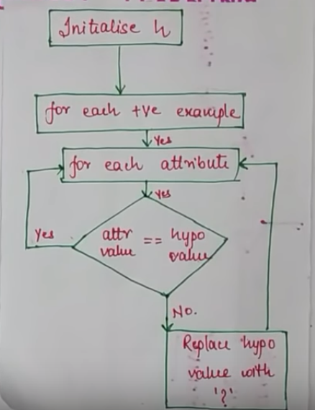
Mistake bound Model
Given an arbitrary, noise-free sequence of label examples of an unknown binary conjunctive concept C over {0,1} N, the learner's task is to predict C(X) for a given X.
Initialize H ={X 1; ~X 1, ~X 2, ~X 3, ...}
Mistake Bound model
Predict according to match between an instance and the conjunction of literals in H
Whenever a mistake is made on a positive example, drop the offending literals from Hs
Figure: Diagram

Slide 11

PAC Learning
Consider:
>An instance space X
>A concept space C = { C:X → {0,1}}
>A hypothesis space H= { H:X → {0.1}}
>An unknown, arbitrary, not necessarily computable, stationary probability distribution D over the instance space X

Slide 12
PAC Learning
The oracle samples the instance space according to D and provides labeled examples of an unknown concept C to the learner.
The learner is tested on samples drawn from the instance space according to the same probability distribution D .
The learner's task is to output a hypothesis h from H that closely approximates the unknown concept C based on the examples it has encountered

Slide 13
PAC Learning
In the PAC setting, exact learning (zero error approximation) cannot be guaranteed
In the PAC setting, even approximate learning (with bounded non-zero error) cannot be guaranteed 100% of the time

Slide 14
VC Dimension
Vapnik–Chervonenkis Dimension
is a measure of the capacity of a space of functions that can be learned by a statistical classification algorithm.

Slide 15
Shattering
A hypothesis class H can shatter N data points for
which we can find a hypothesis H that separates
the positive examples from negative for every problem,
then we say H shatters N points.

Slide 16
THANK YOU

